Slide 1
Shook: why those San Francisco salaries may not be the answer
OR…
A Salary & Cost of Living Comparison by Major US City

Slide 2
The Why
When considering job opportunities, there are lots of questions to consider:
How do salaries vary by city? By job title?
What does cost of living look like in various cities?
How do job salaries vary across locations taking into account cost of living?
What can we learn about the job markets and industry trends?

Slide 3



The What
21 Local Pay Reports from Glassdoor
Data from 6.2017 to 2.2019.
Information for 85 different job titles across 10 cities, as well as national data
Cost of living data from the Numbeo
Largest database of crowd sourced information on cities and countries
Average prices of typical consumer items, dining out, transportation, rent, etc.

Slide 4
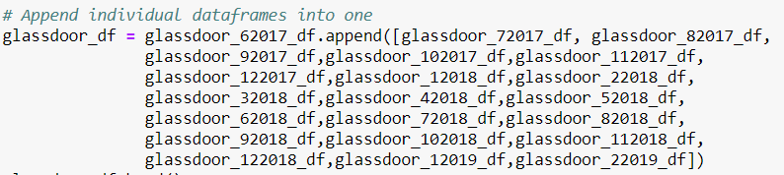
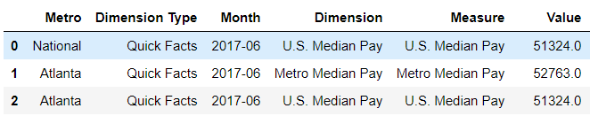
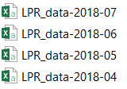

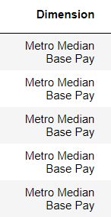
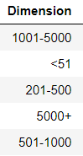
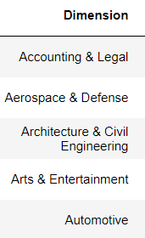


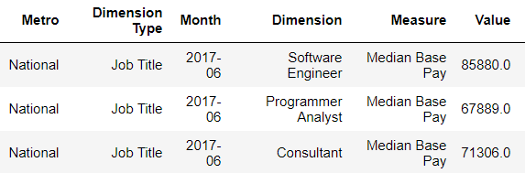
The Nuts & Bolts
1
Median base pay
Company size
Industry type

Slide 5
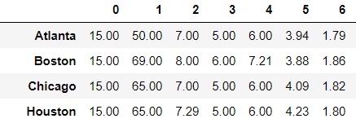
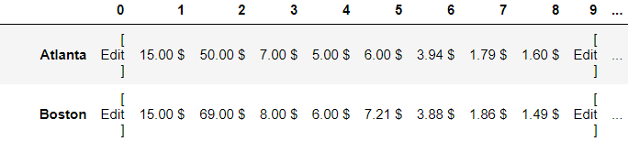
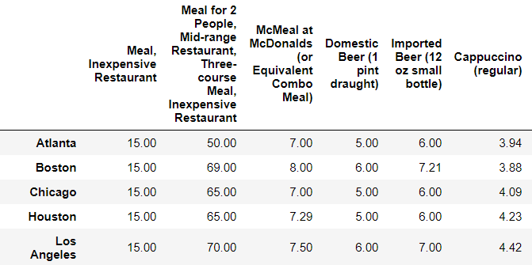
1
55 variables for cost of living

Slide 6
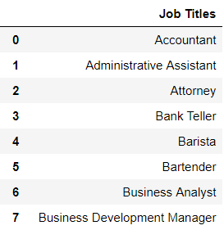
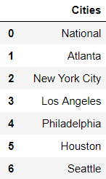
The Magic
Users are then asked:
What city (or cities) are you interested in?
What job(s) are you interested in?
Users are presented with a list of 85 job titles and a list of 10 cities.

Slide 7



Comparing salaries across Chicago, San Francisco and Philadelphia

Slide 8
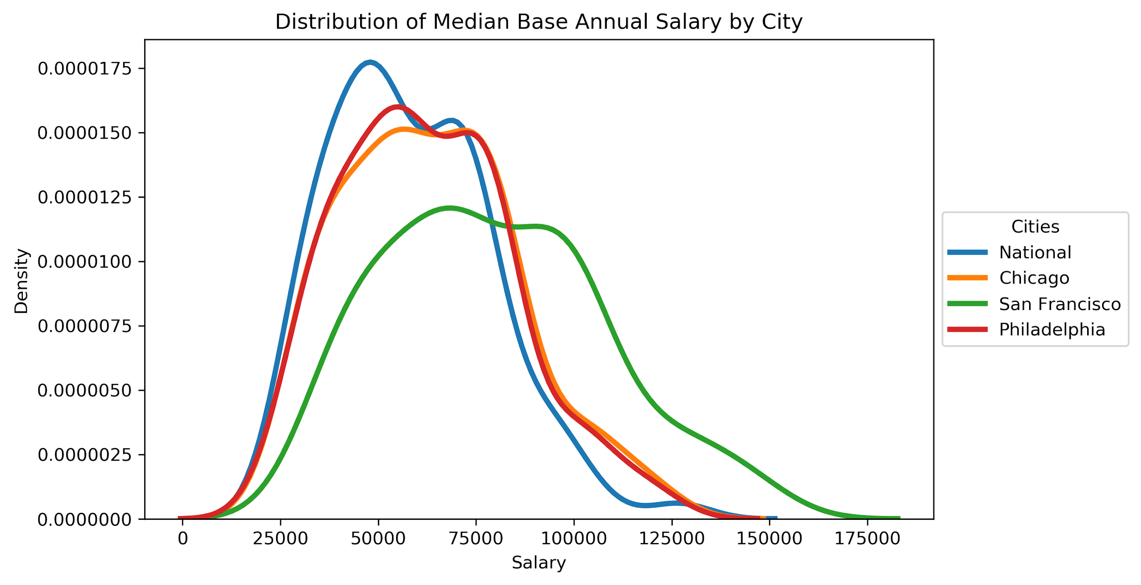
Distribution of Median Base Annual Salary by City

Slide 9
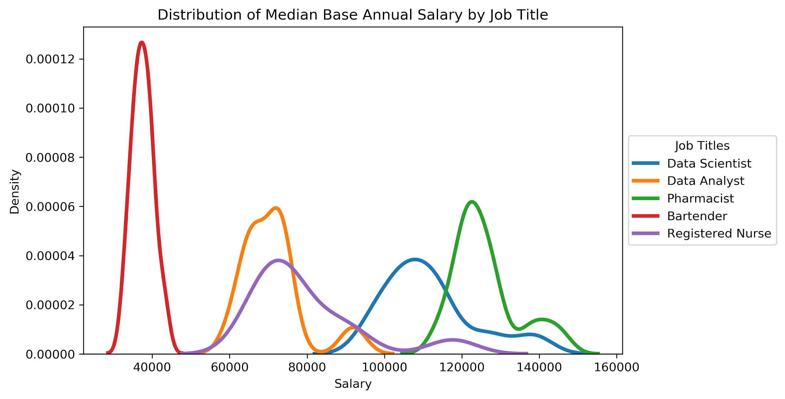
Distribution of Median Base Annual Salary by Job Title

Slide 10
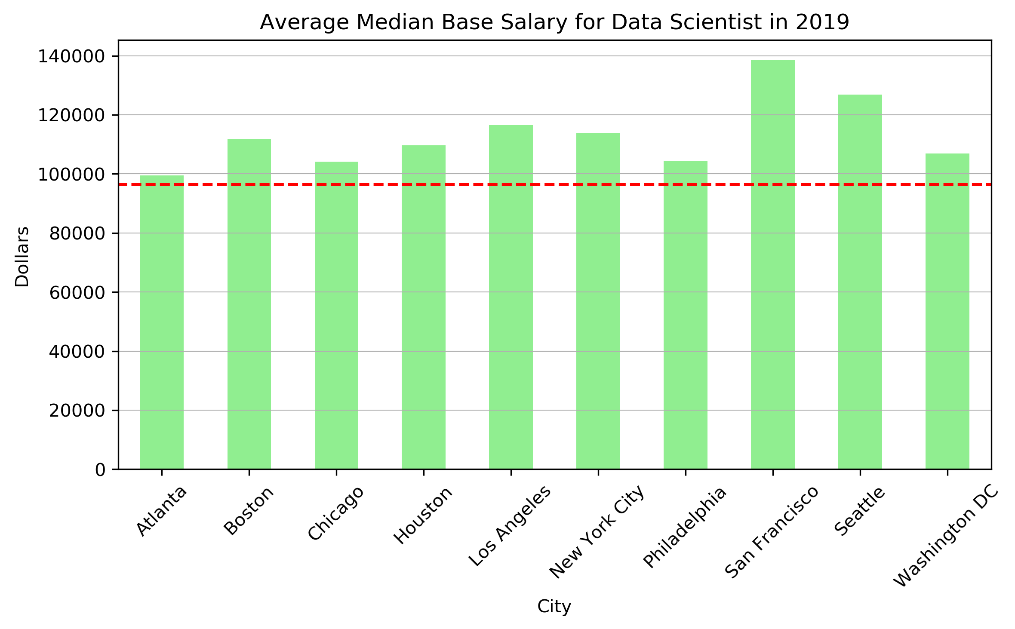
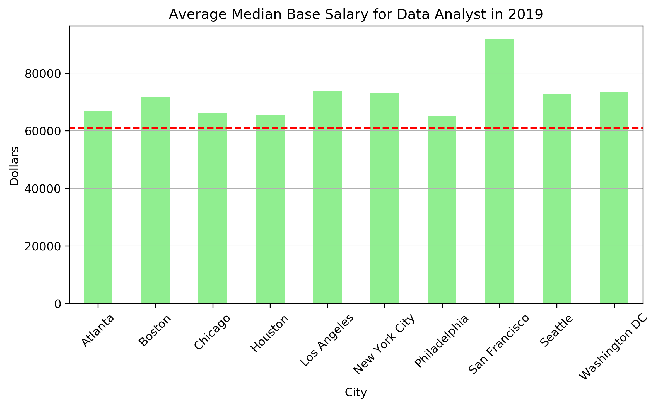
Salaries across different cities ( aka speak dollars to me)
Data Scientist Data Analyst
There is about a 40% salary increase associated with being a Data Scientist vs. being a Data Analyst

Slide 11
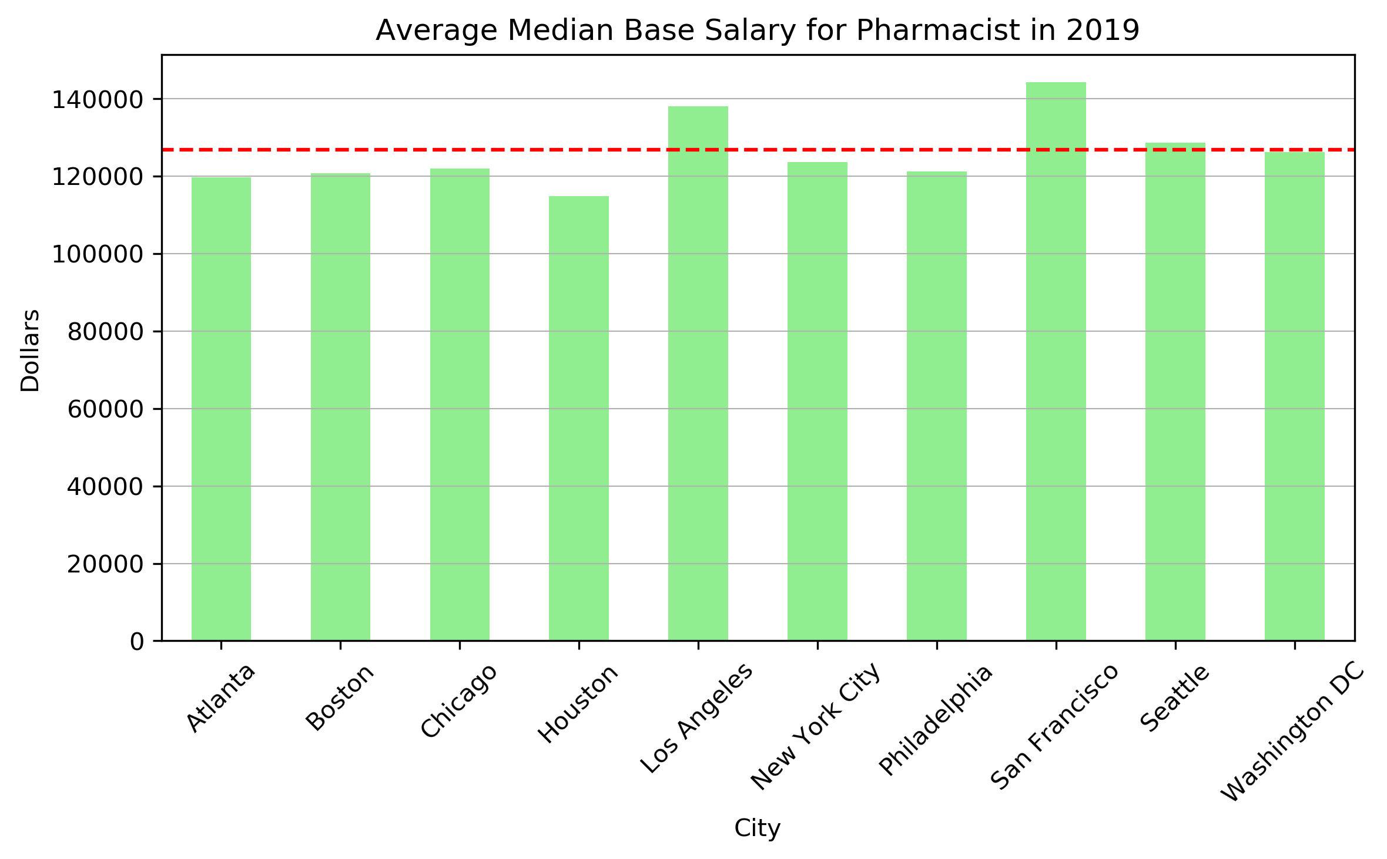
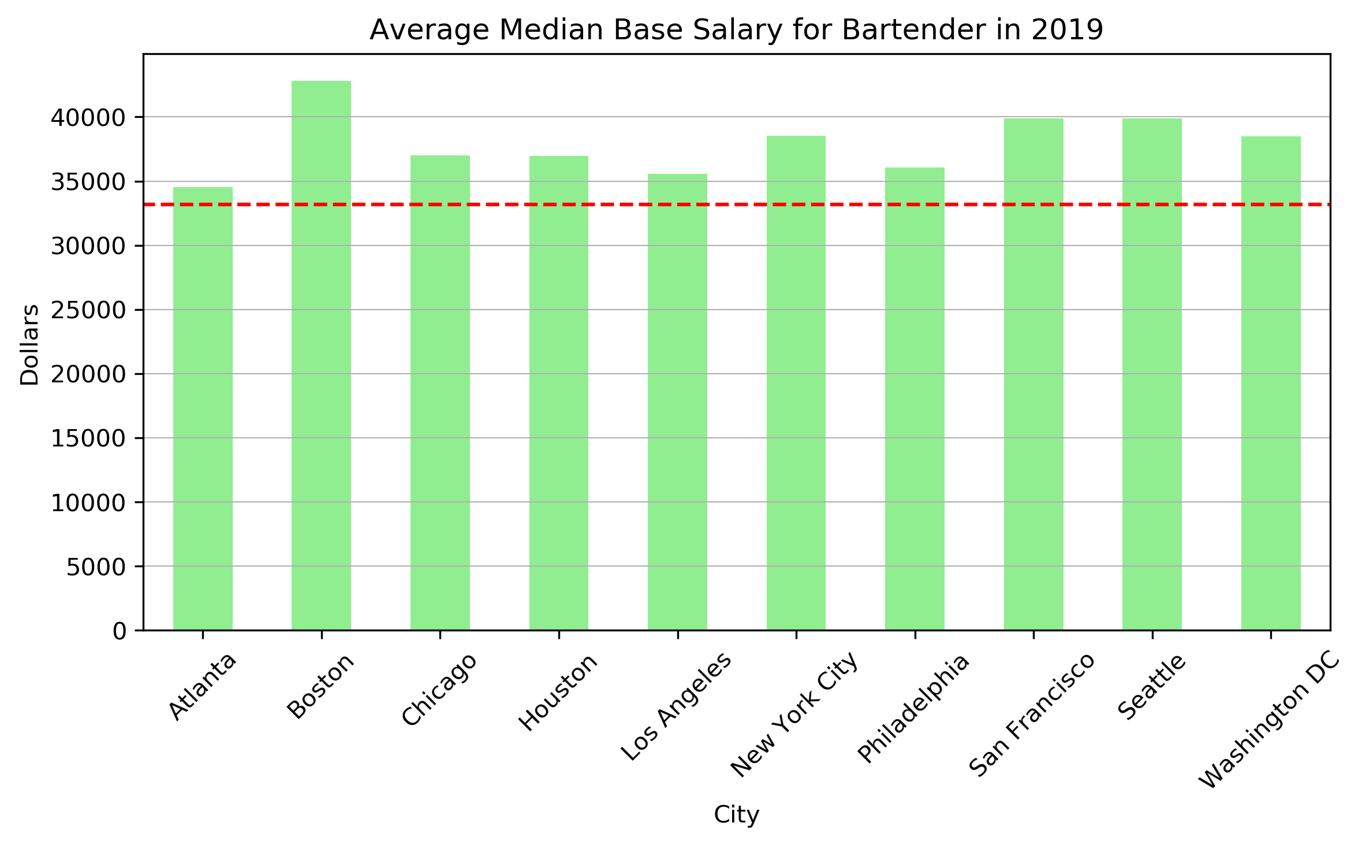
Pharmacists have the highest
salaries across different cities.
To be or not to be...
A bartender (in Boston)?

Slide 12

But salary isn’t the only piece of the puzzle:
How does cost of living impacts the salary gap between cities?

Slide 13
Cost of Living Assumptions
Housing - average monthly rent
Restaurants - cost of dining out once or twice a week along with the occasional coffee or drink
Groceries - estimated cost of commonly purchased grocery items
Transportation - cost of a monthly pass along with an occasional taxi ride
Utilities - estimated cost of basic utilities (electricity, heating, cooling, water, garbage) and internet service
Leisure - monthly cost of a gym membership and a visit to the movies
Childcare - monthly cost for one child in preschool/kindergarten/primary private school

Slide 14
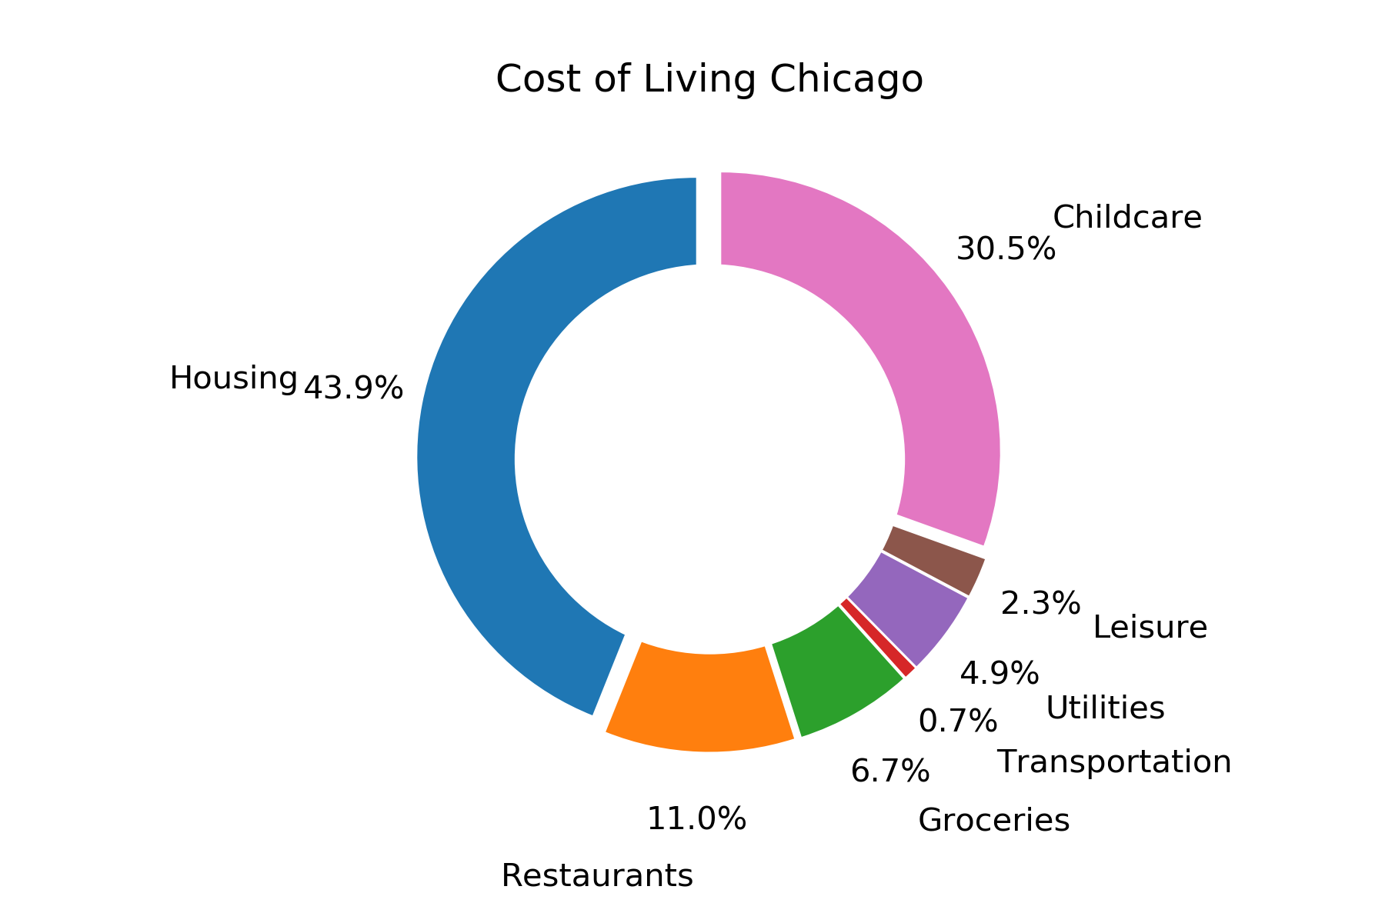
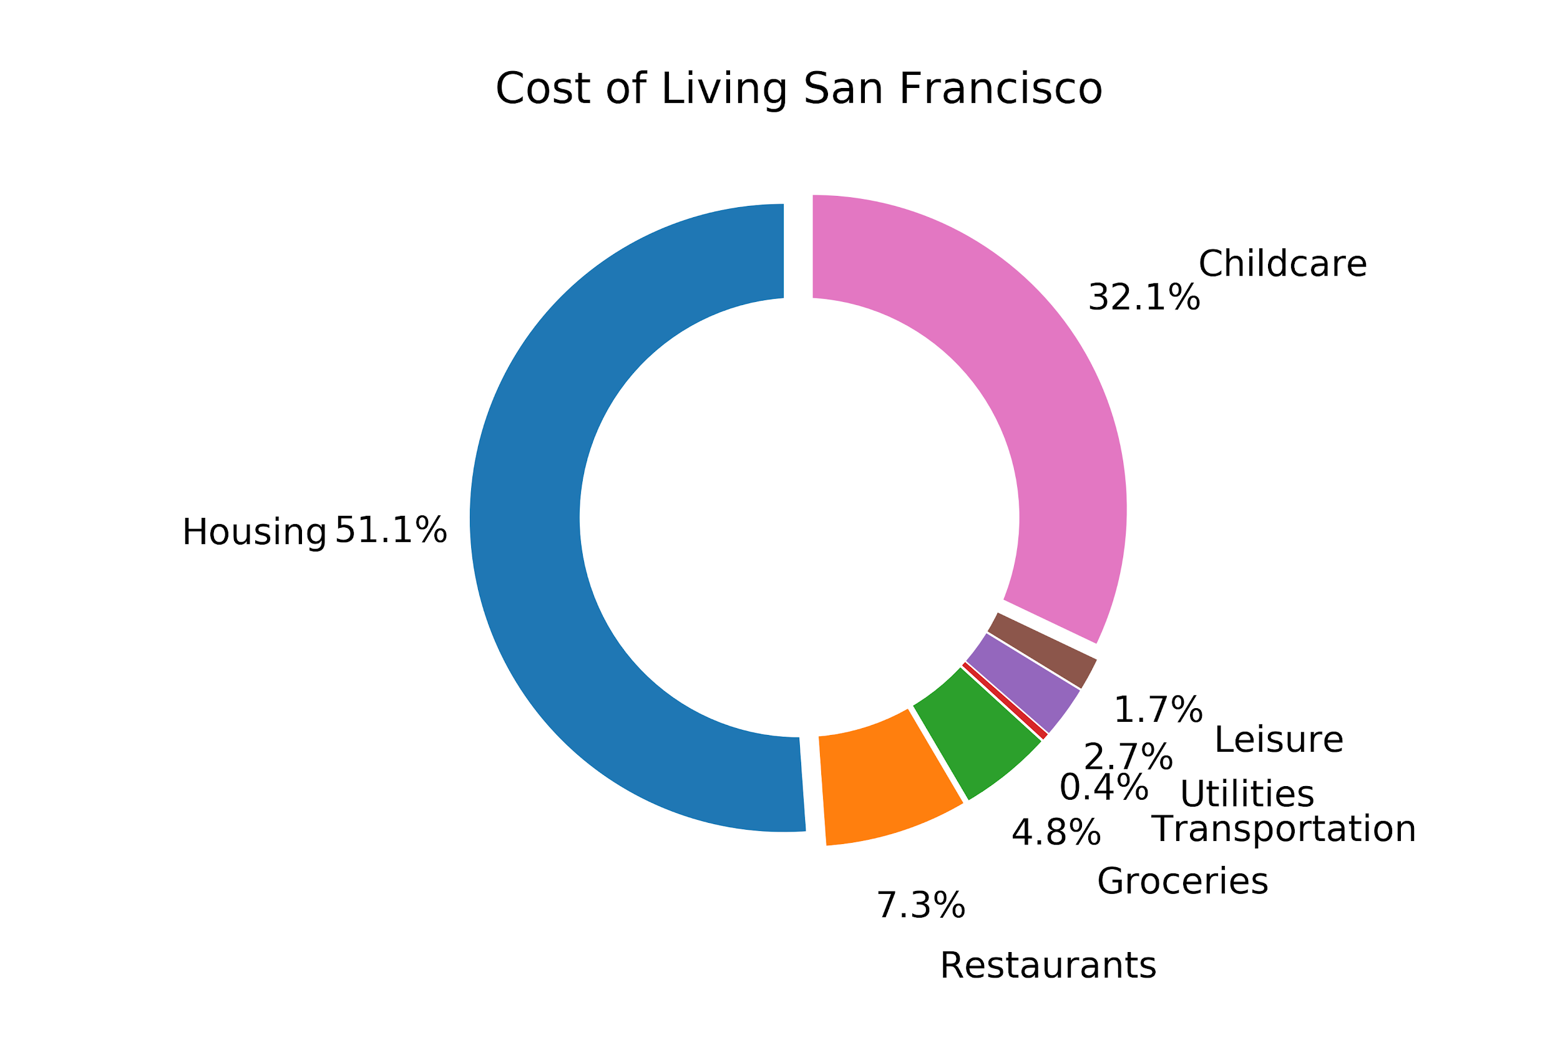
Cost of Living:
San Francisco
Chicago

Slide 15
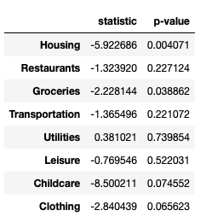
Statistically speaking
Grouped cost of living variables into categories
Performed a series of pairwise t-tests
**
*
Chicago vs. San Francisco
Notes:
Housing (1 bedroom, 3 bedroom, city center, outside city center)

Slide 16
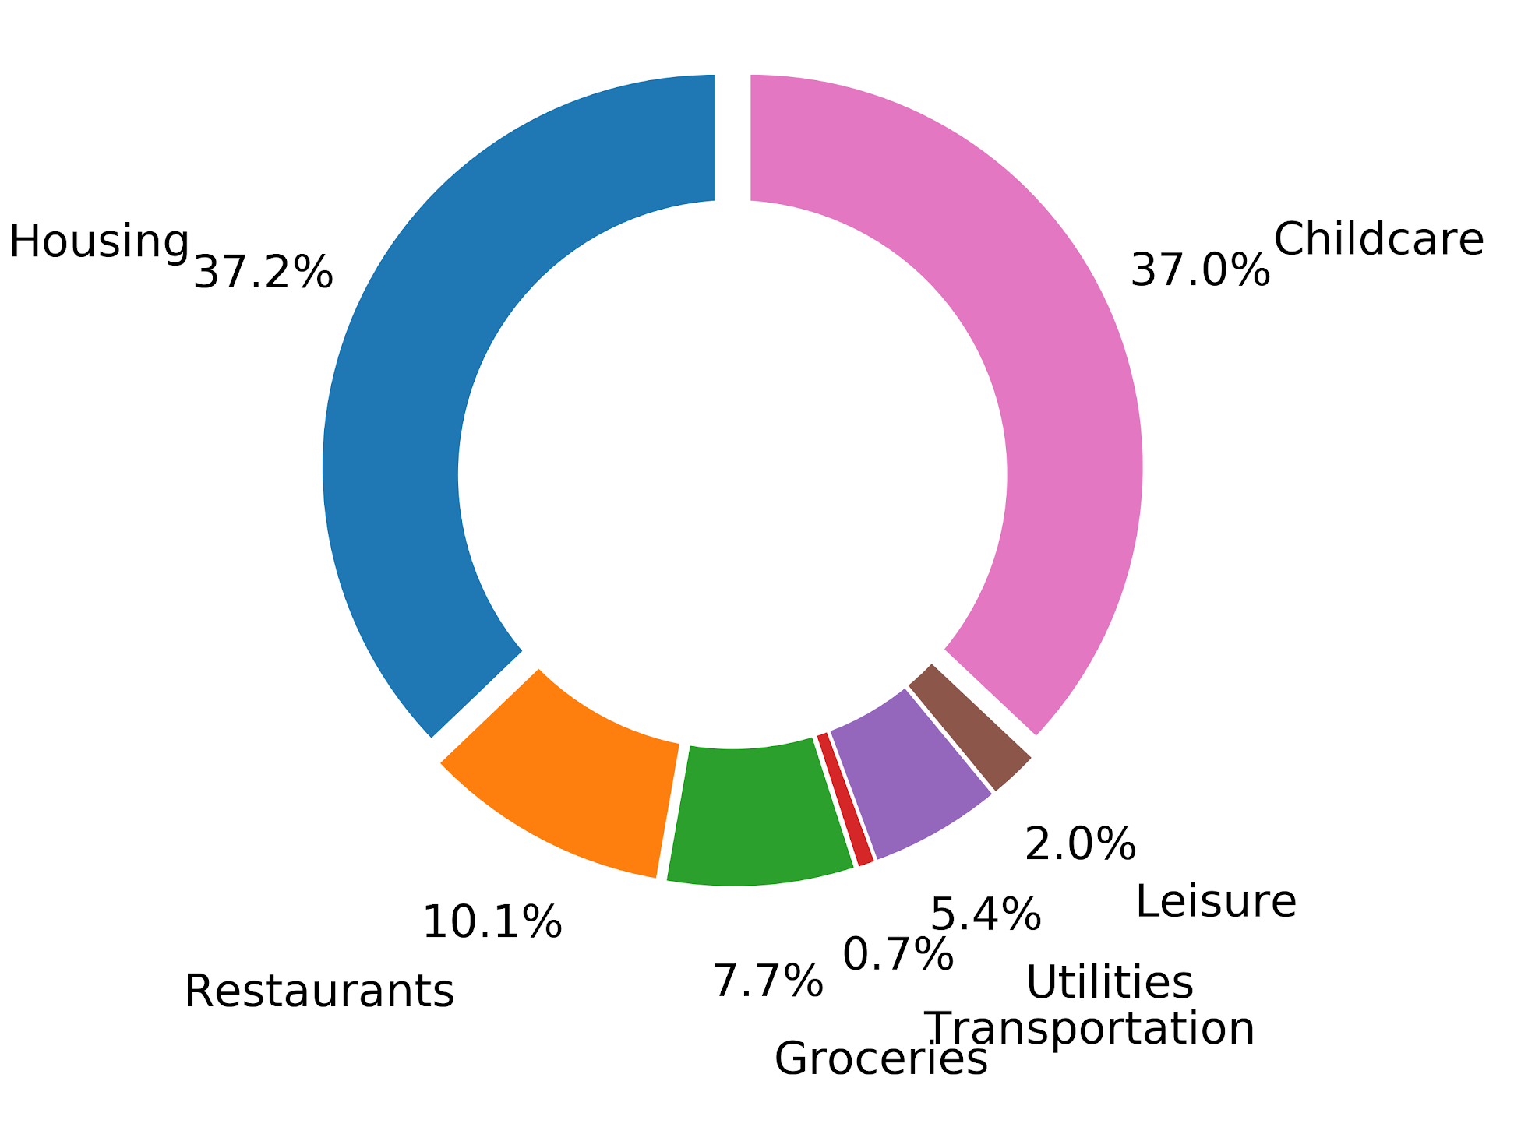
Cost of Living:
Philadelphia
Chicago
Notes:
The housing and child care are very close

Slide 17
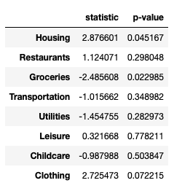
Statistically speaking
Grouped cost of living variables into categories
Performed a series of pairwise t-tests
*
*
Chicago vs. Philadelphia
Notes:
Housing (1 bedroom, 3 bedroom, city center, outside city center)

Slide 18
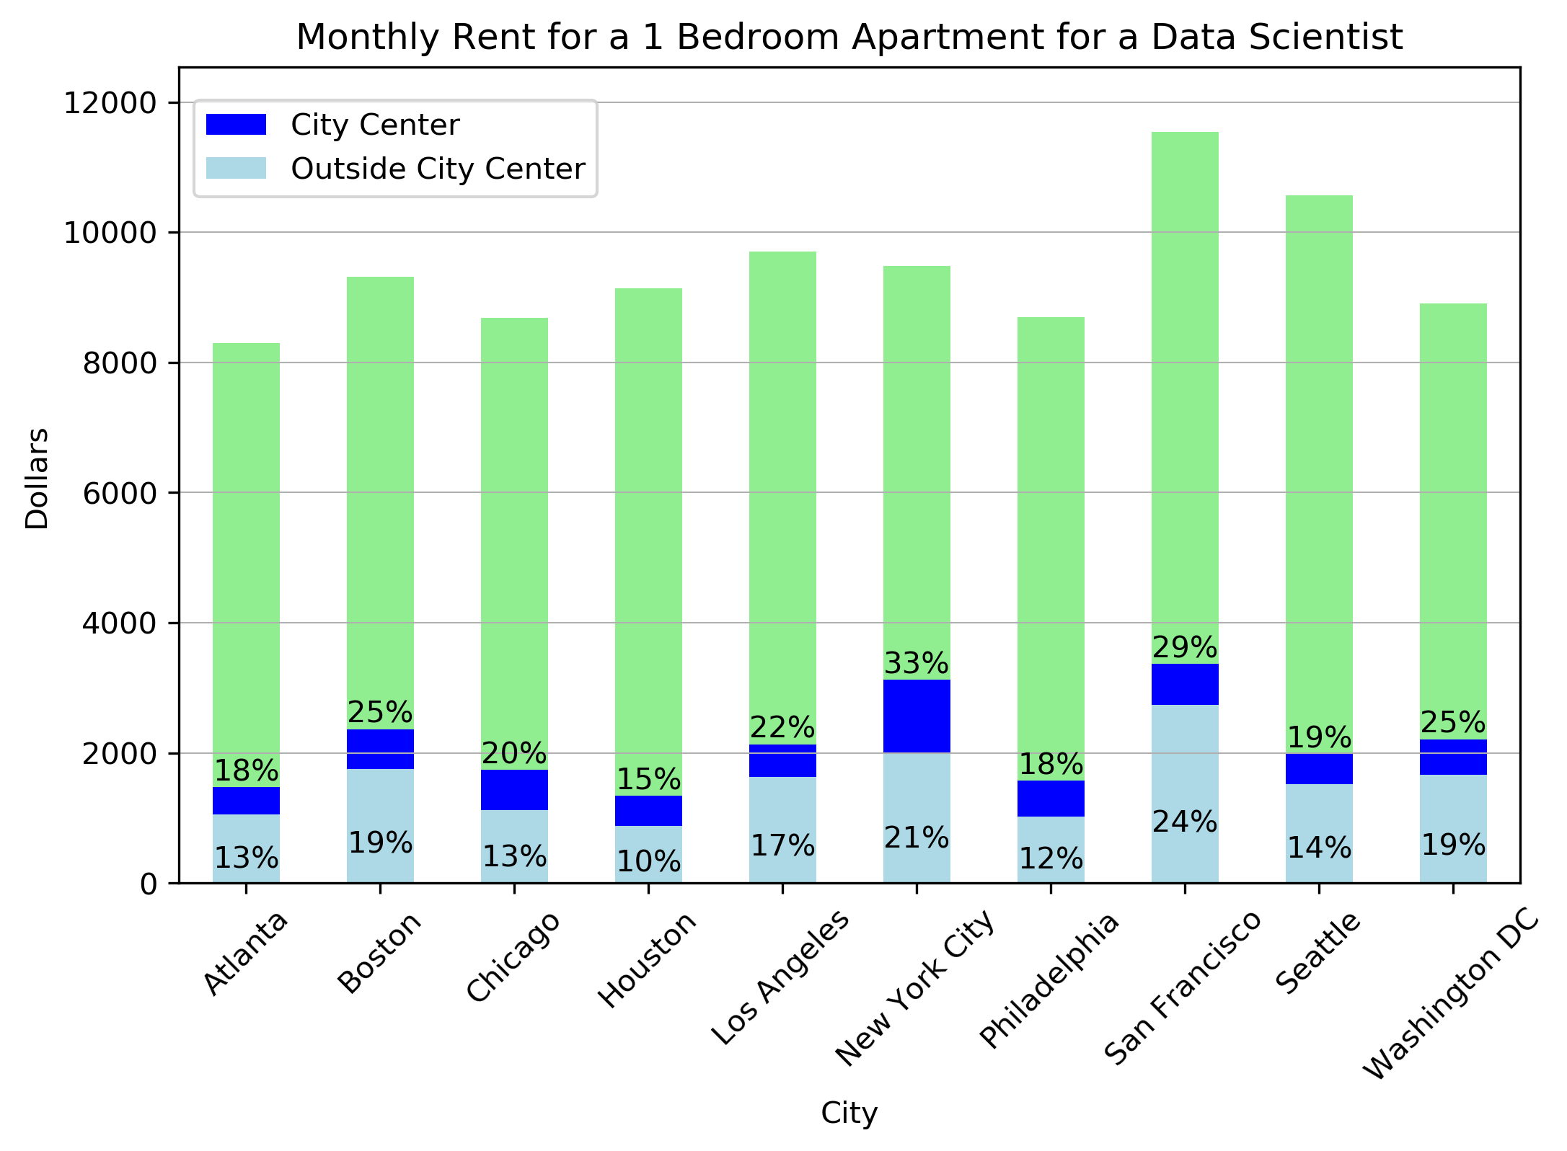
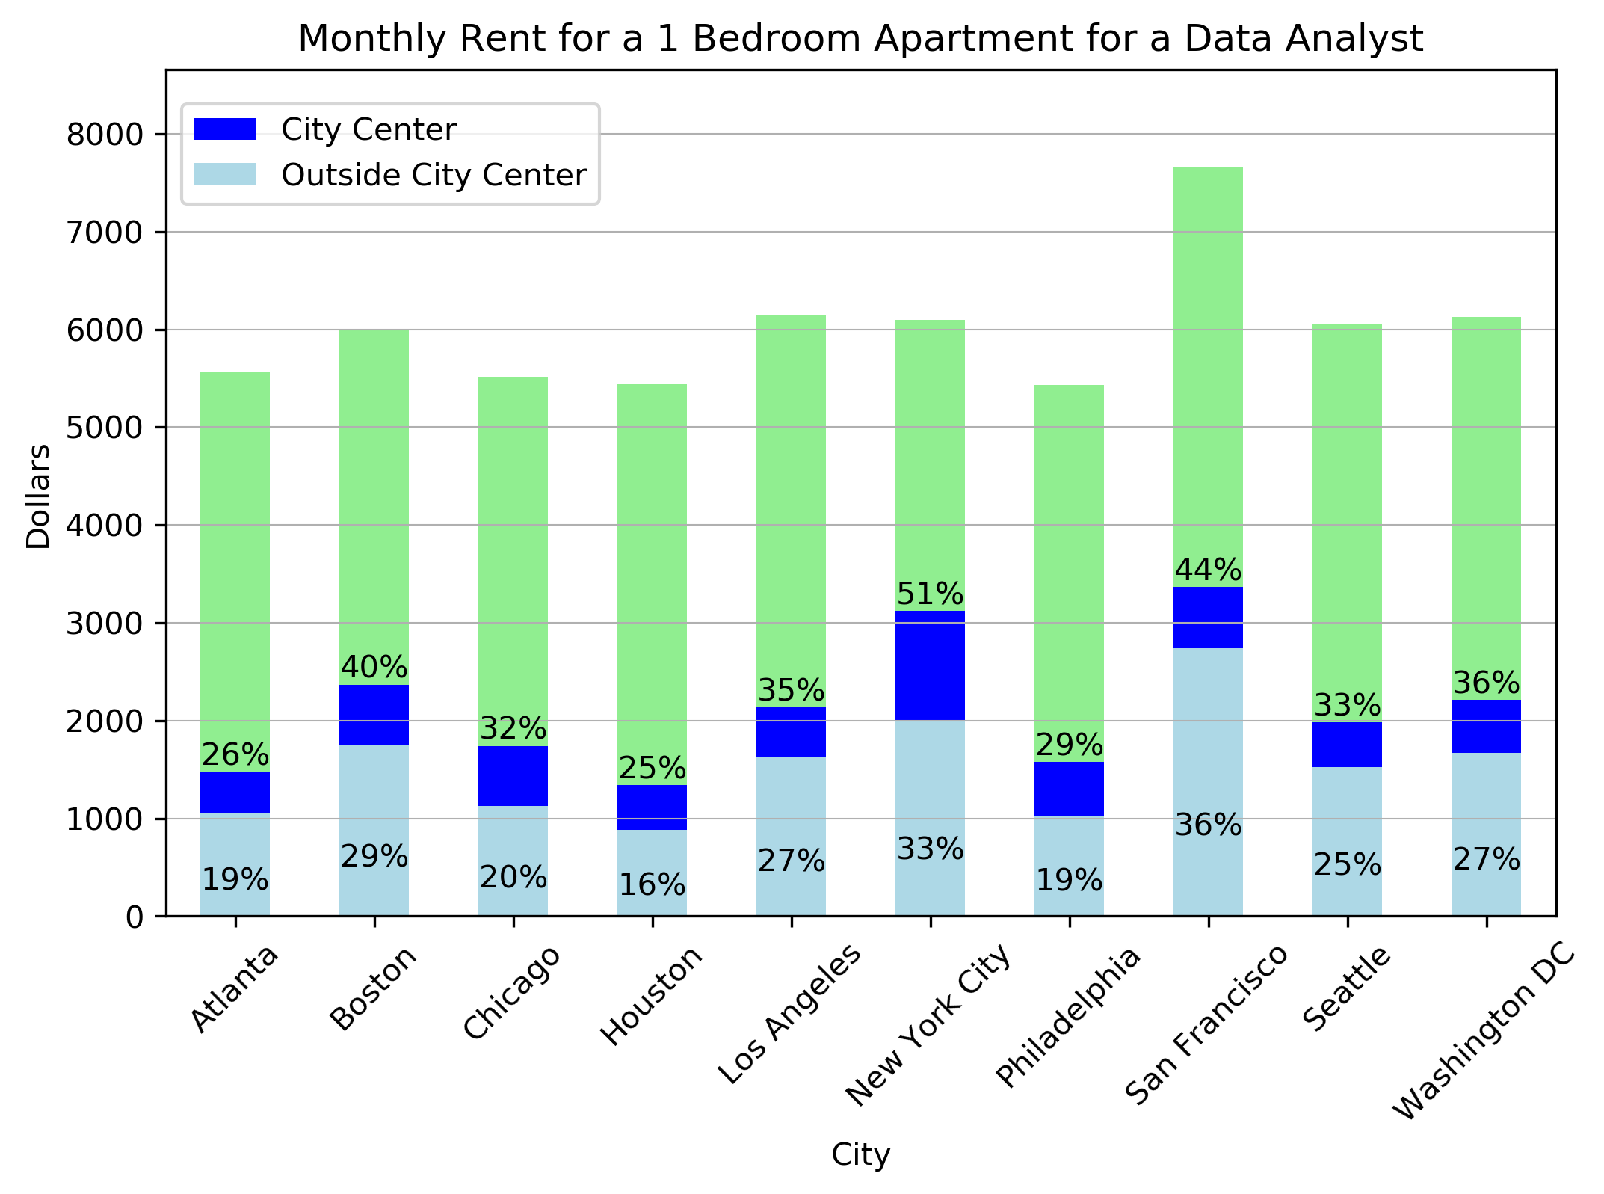
Rent to Salary Ratio:
Data Scientist Data Analyst
Notes:
So what does it mean to have statistically significant in housing so we did further analysis between Chicago and San Francisco, and found that there is a high percentage of salary, 30% in the case of being a data Scientist vs 44% being a Data analyst to live in SF vs 20% and 32% respectively to live in Chicago.
Salary in green, monthly rent 1 bedroom for City center in blue, and monthly rent for outside city center in cyan.

Slide 19
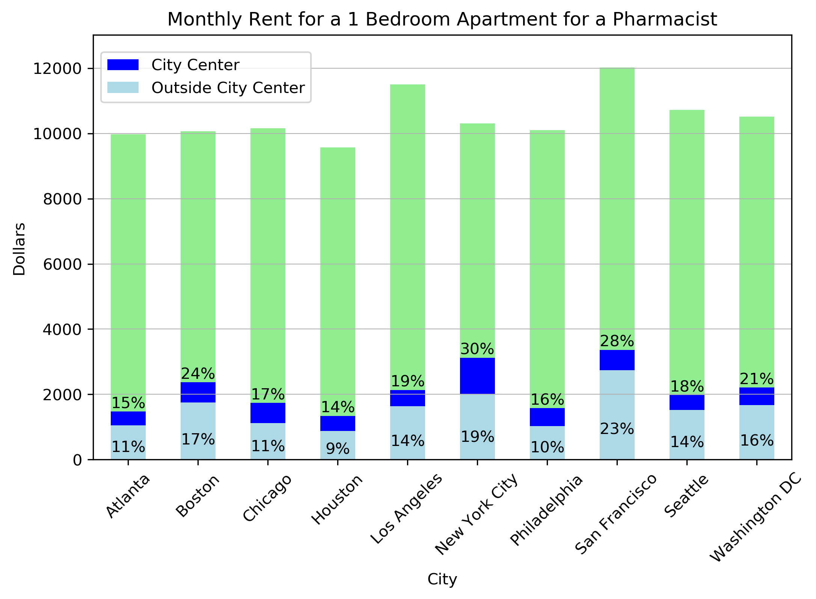
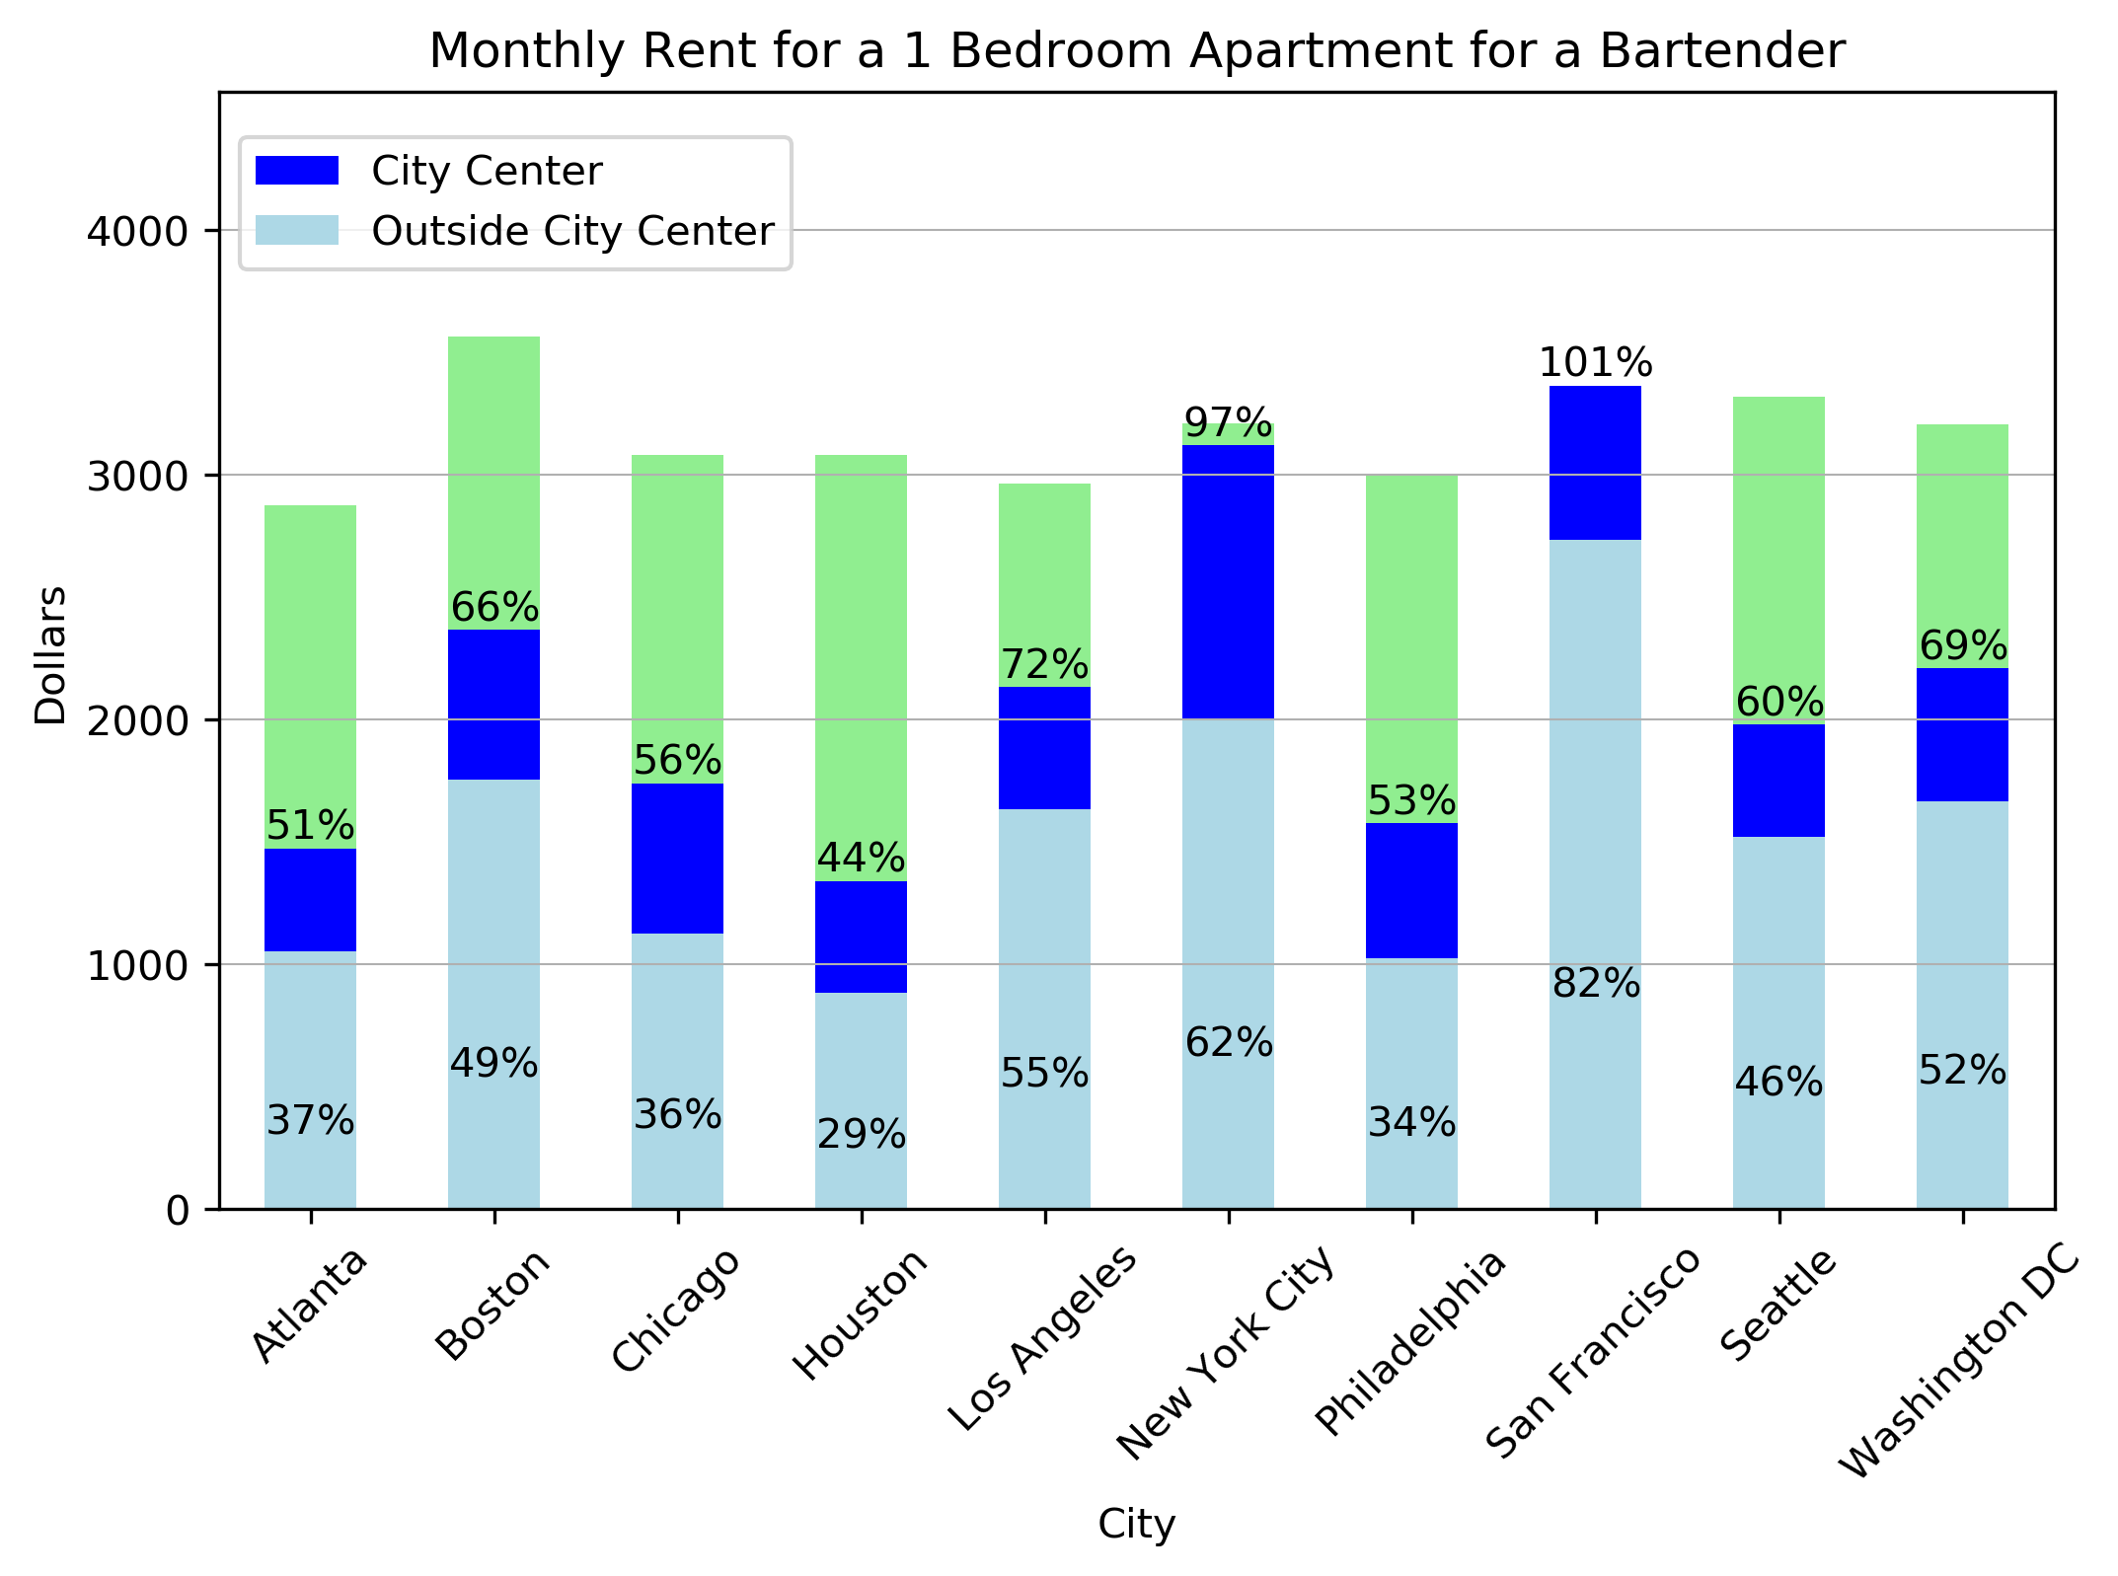
Rent to Salary Ratio:
Pharmacist
Bartender
Notes:
It is safe to assume there is no bartender who would live in 1 bedroom apartment in City Center in San Francisco by him/herself?

Slide 20
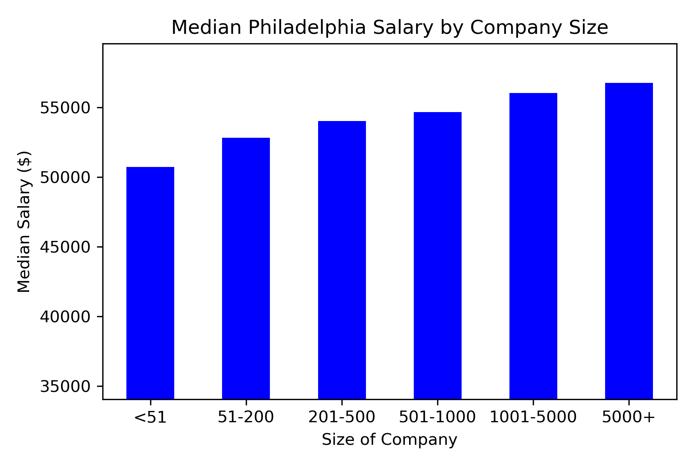

Additional Insights: Company Size

Slide 21
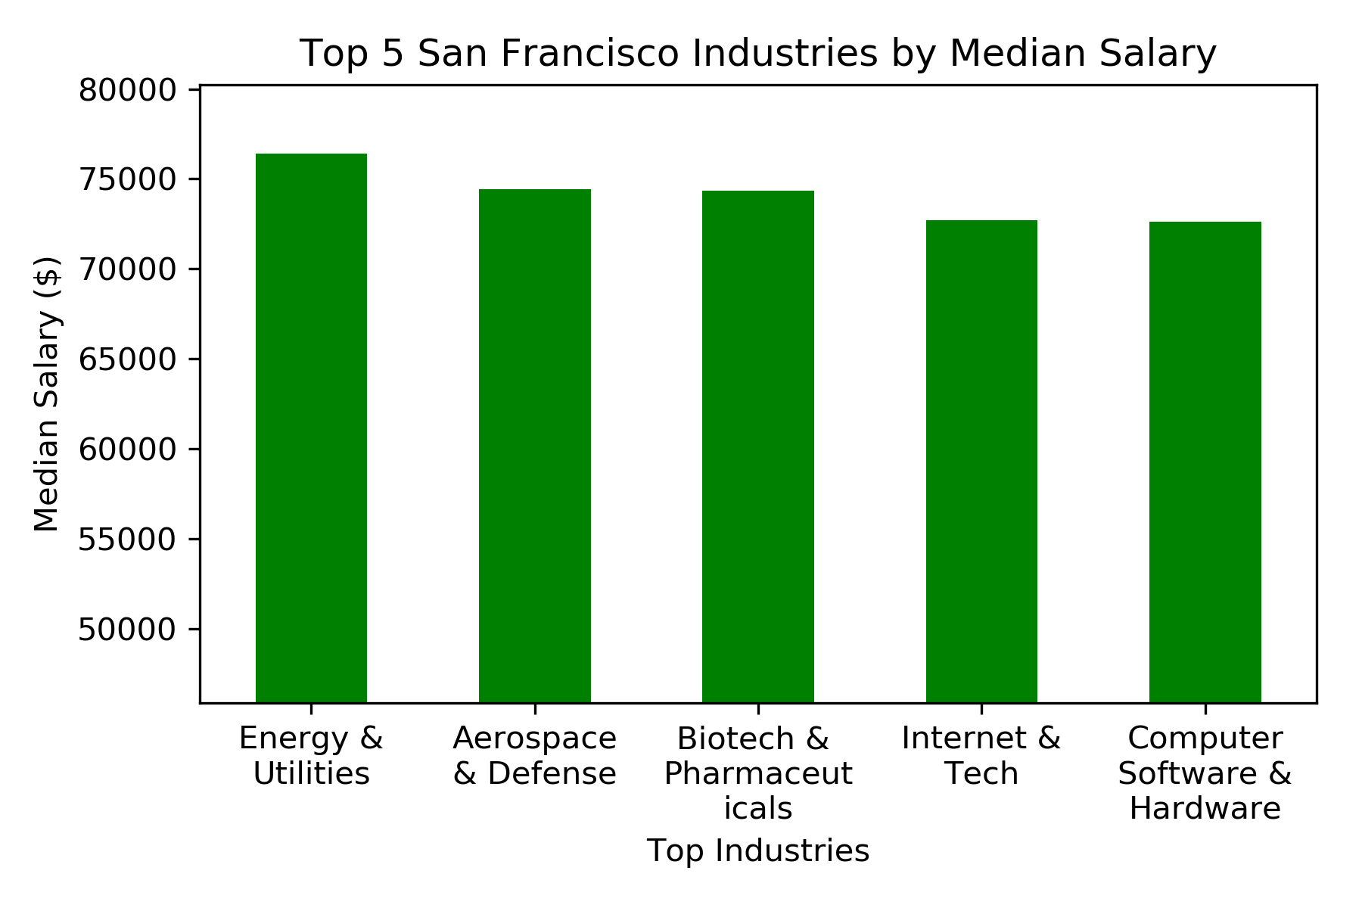
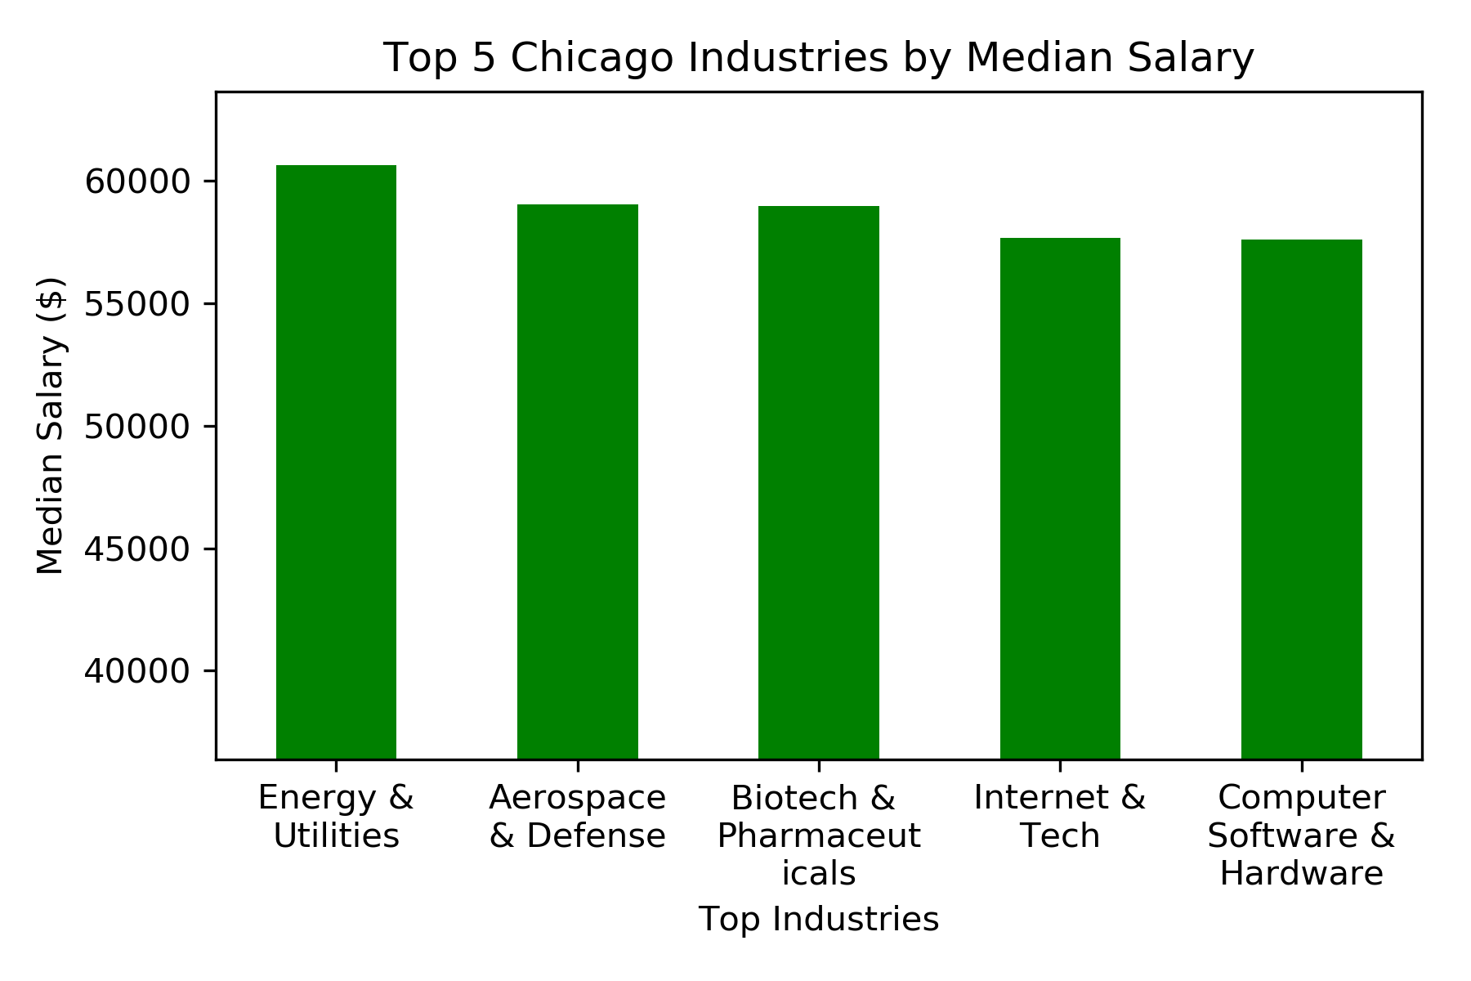

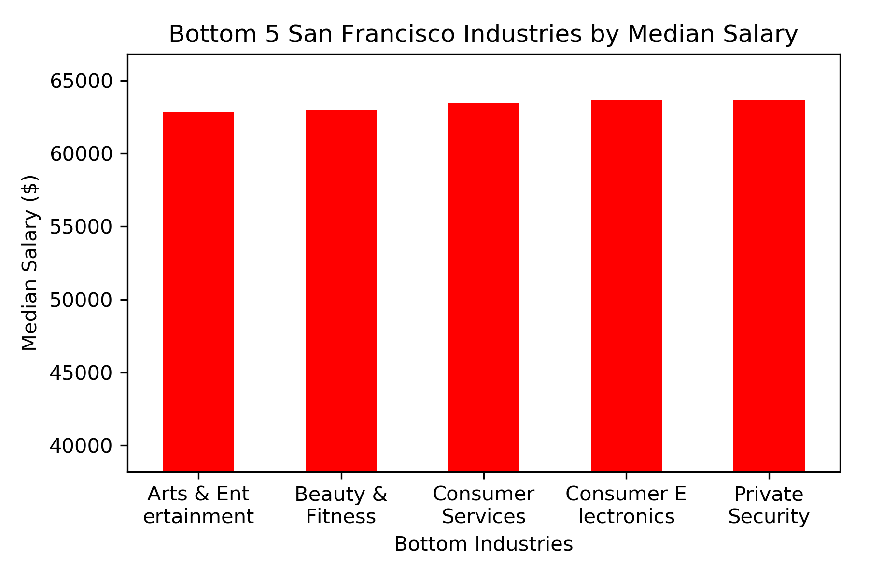
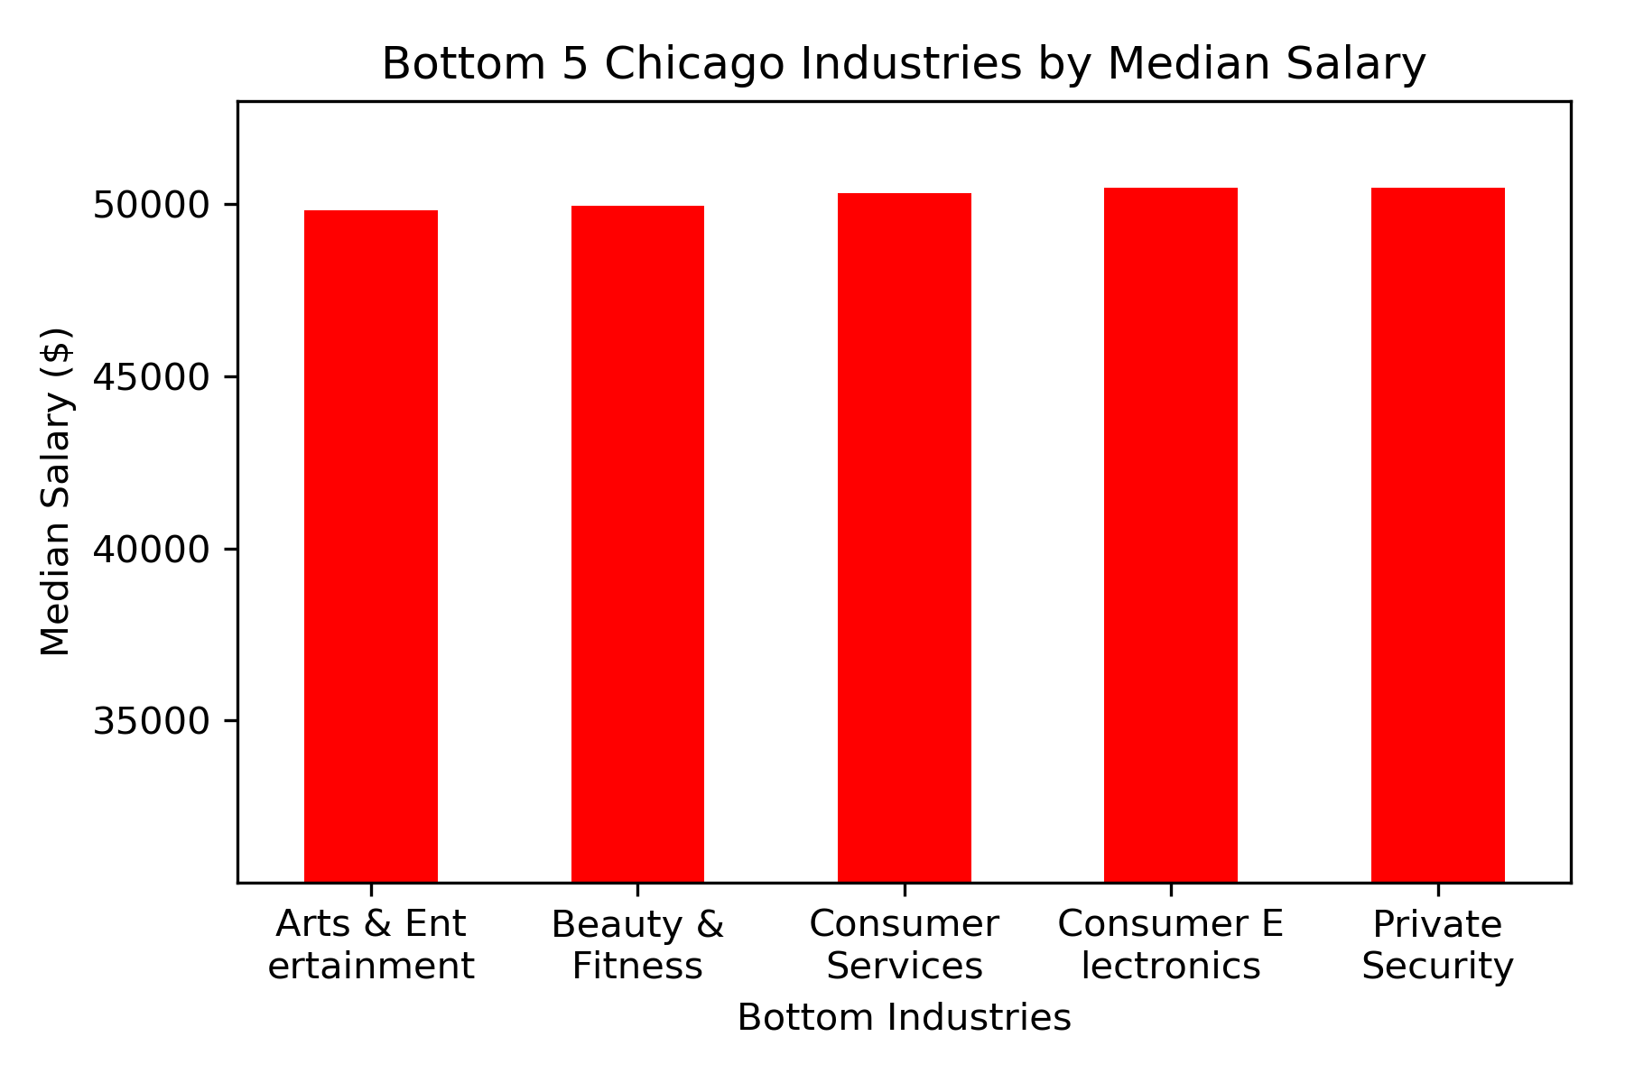

Additional Insights: Industry Trends

Slide 22
In summary
Distribution of salaries vary by job titles and locations
Some jobs are not very different across locations
What is in a job title?
Housing is a very important factor to consider in terms of cost of living.
Dining out and groceries may be significant as well.
Childcare can be expensive.
Notes:
Discuss your findings. Did you find what you expected to find? If not, why not? What inferences or general conclusions can you draw from your analysis?

Slide 23
Reflections
Future Work
No publicly available API
Limited salary data
Include more cities
Include more job titles
Median base annual salary
Cost of living measure
Consider overall monthly spending, cost of living index, etc.
Incorporate more related data sources
Refine our model for estimating monthly cost of living
Analyze job trends using more data points from the past (e.g. past 5-10 years)
Build an interface so users can use our methodology to evaluate various scenarios
Notes:
* Discuss any difficulties that arose, and how you dealt with them
* Discuss any additional questions that came up, but which you didn't have time to answer: What would you research next, if you had two more weeks?

Slide 24
Questions?
Thank you!
For more information:
GitHub repository
Write up of the analysis

Slide 25
Extra Slides

Slide 26
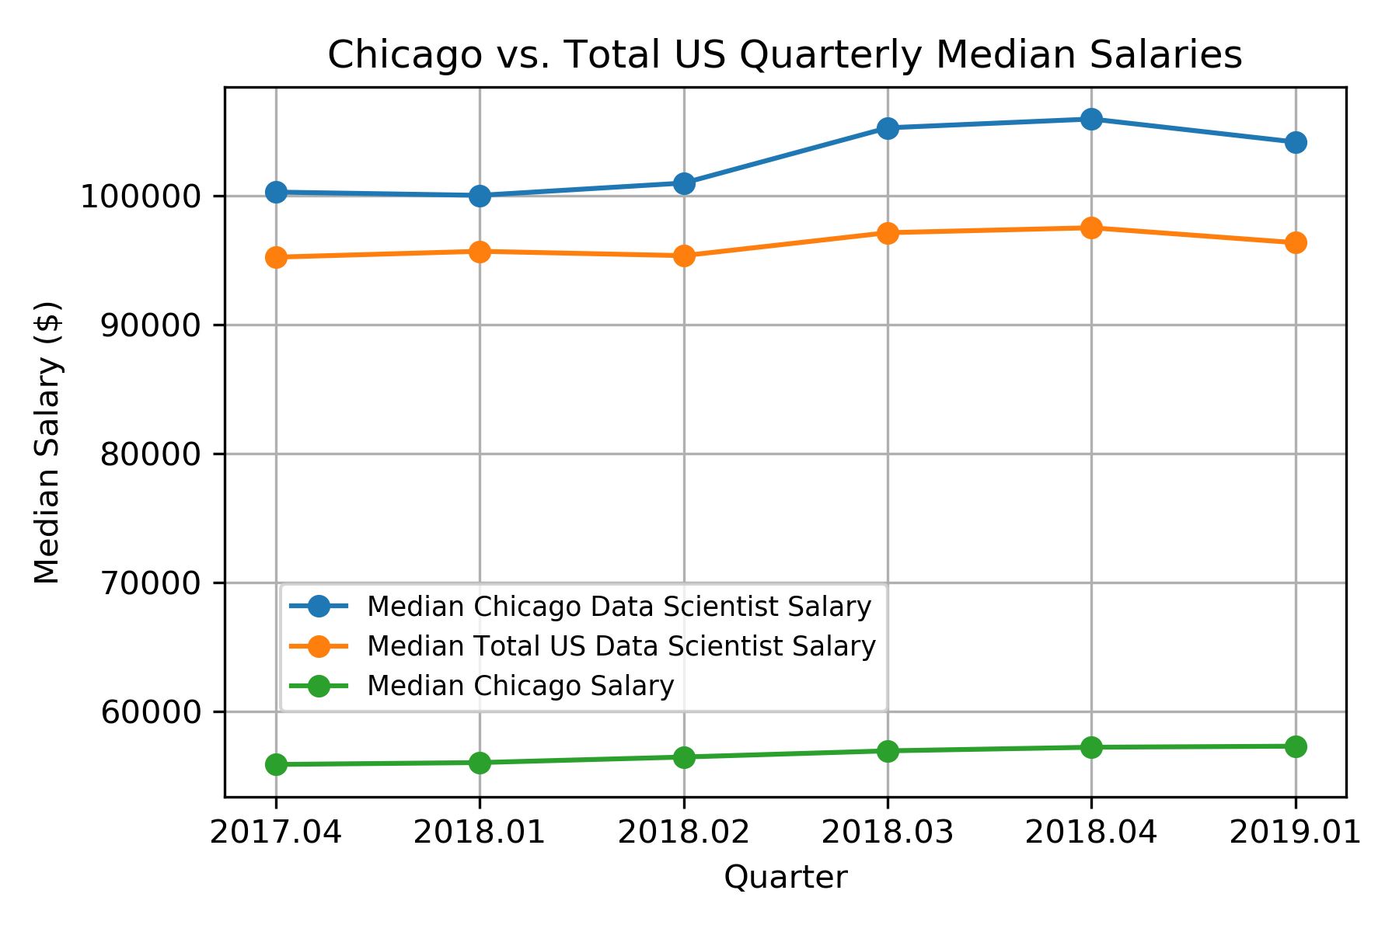
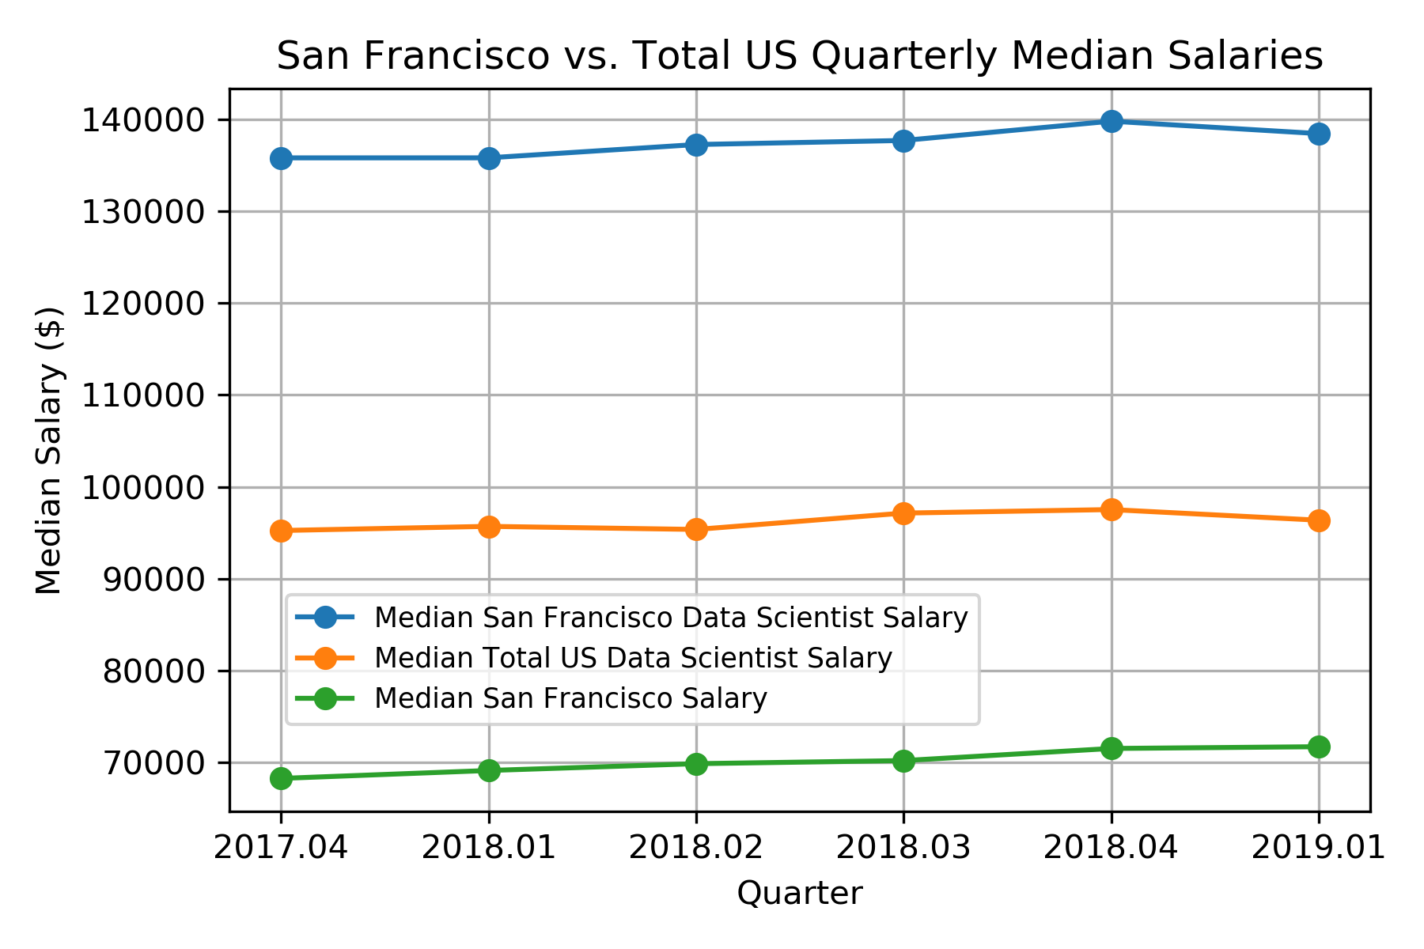
Data Scientist Salary
Chicago
Data Scientist Salary
San Francisco
23.5% <
Data Scientists in Chicago earn $106,328 (up 5.6%), which is 9.1% more than the national median for that job
Data Scientists in SF earn $139,039 (up 2.9%), which is 43.8% more than the national median for that job

Slide 27
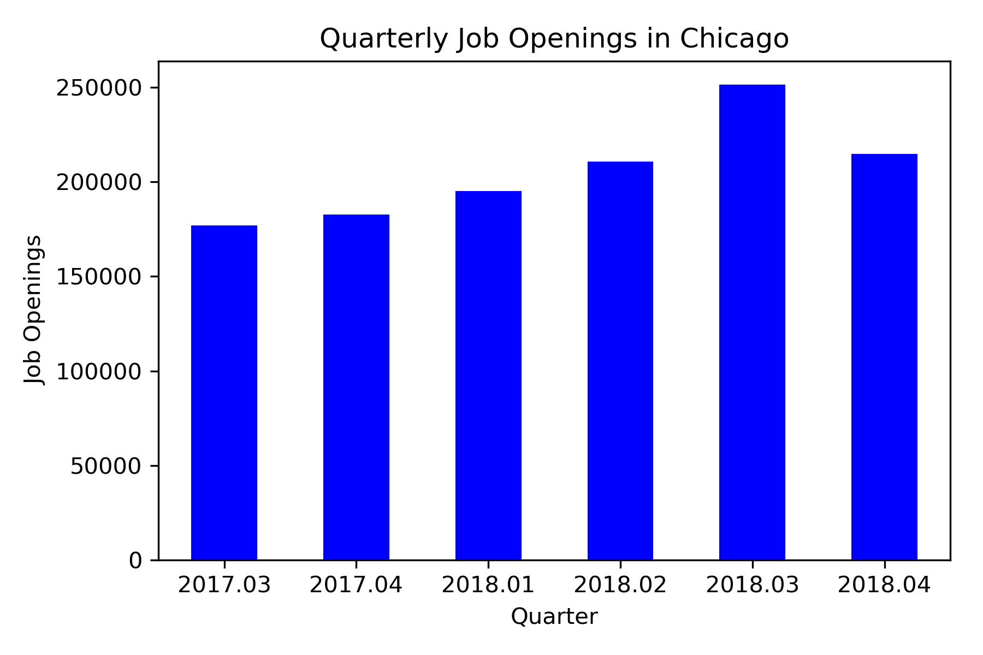
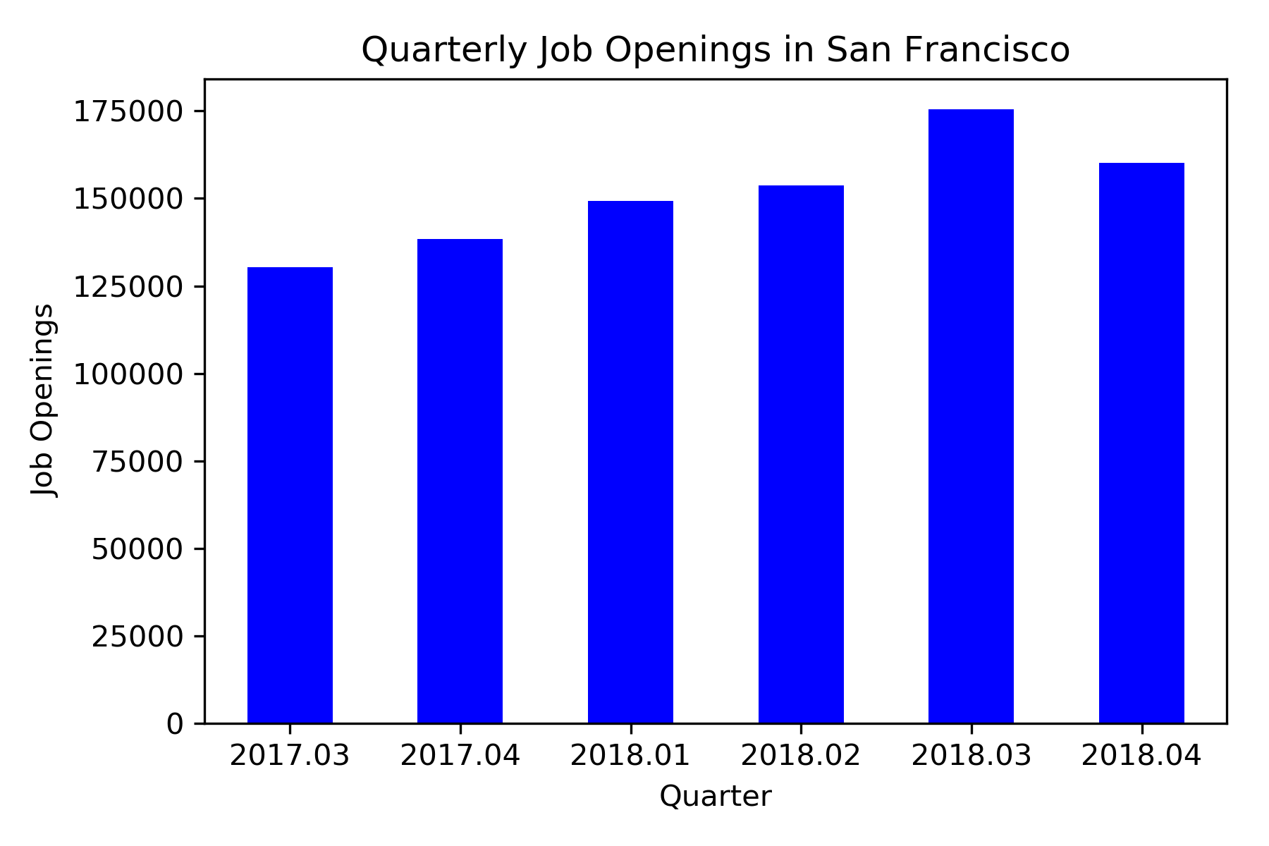
Job Openings
Chicago
Job Openings
San Francisco
36.6% >
Currently, there are 217,651 total job openings in Chicago (an increase of 20.7% from same time last year)
Currently, there are 159,308 total job openings in San Francisco (an increase of 14.4% from same time last year)

Slide 28
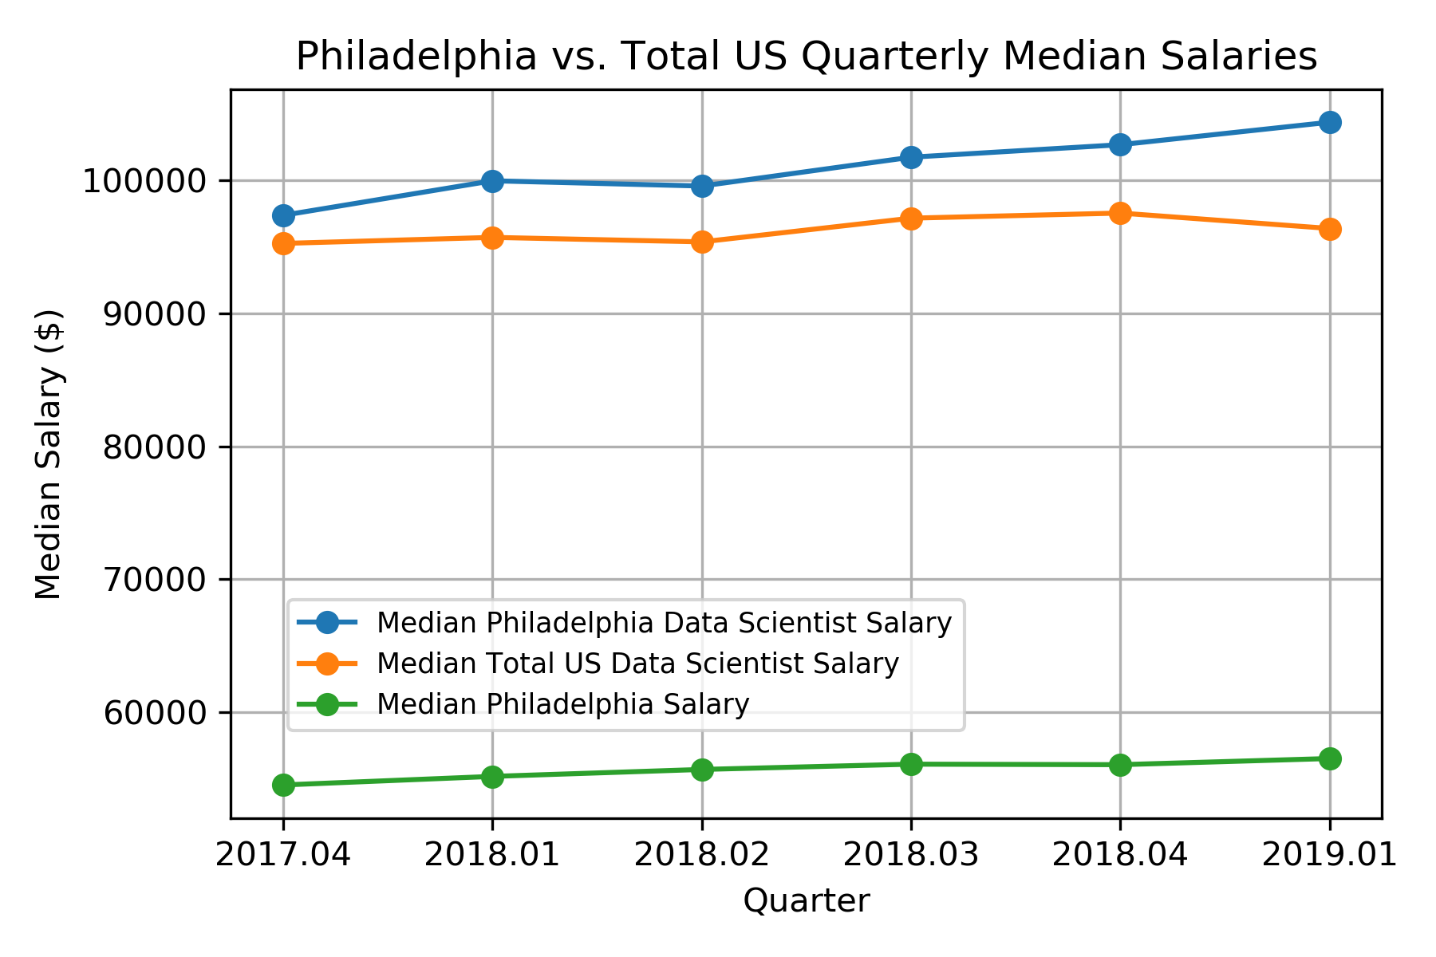
Data Scientist Salary
Chicago
Data Scientist Salary
Philadelphia
2.6% >
Data Scientists in Chicago earn $106,328 (up 5.6%), which is 9.1% more than the national median for that job
Data Scientists in Philadelphia earn $103,644 (up 6.7%), which is 6.4% more than the national median for that job

Slide 29
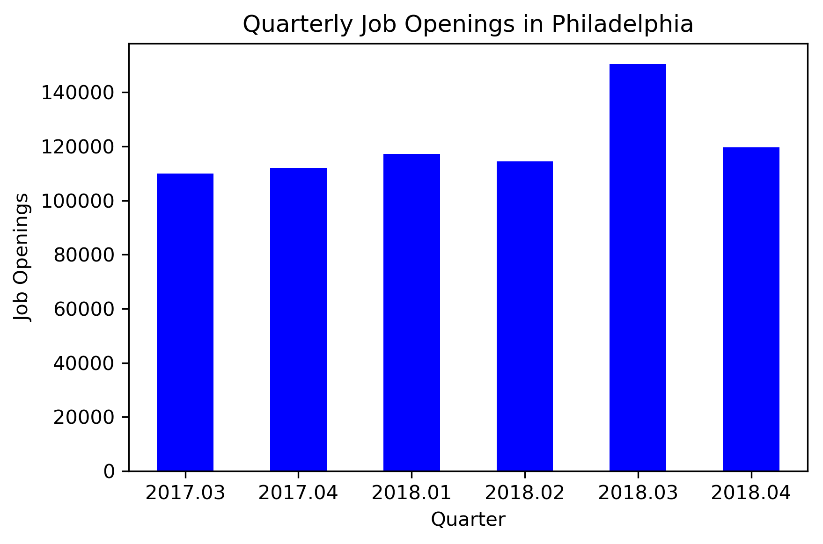
Job Openings
Chicago
Job Openings
Philadelphia
78.2% >
Currently, there are 217,651 total job openings in Chicago (an increase of 20.7% from same time last year)
Currently, there are 122,156 total job openings in Philadelphia (an increase of 12.2% from same time last year)

